Slide 1



Consumer Goods Ad-hoc Insights
Atliq Hardware
USING SQL
PRESENTED BY : SHUBHAM SARPATE

Slide 2
agenda
Company Overview/ Problem statement
Atliq’s business their markets and products
Data inputs
Ad-hoc request along with the result, visualization and insights

Slide 3
Company Overview/ Problem statement
About company
Atliq Hardware (imaginary company) is one of the leading computer hardware producers in India and well expanded in other countries too.
Atliq Hardwares supplies electronic goods to the retailers (customers of Atliq Hardwares) like Croma,Best buy,Amazon,Flipkart, etc., who then sells the goods to the end consumers.
Problem Statement
The management noticed that they do not get enough insights to make quick and smart data-informed decisions. They want to expand their data analytics team by adding several junior data analysts.
Task
There are 10 ad hoc requests to run a SQL query to answer these requests.
The target audience of this Project is top-level management – and create a presentation to show the insights.

Slide 4
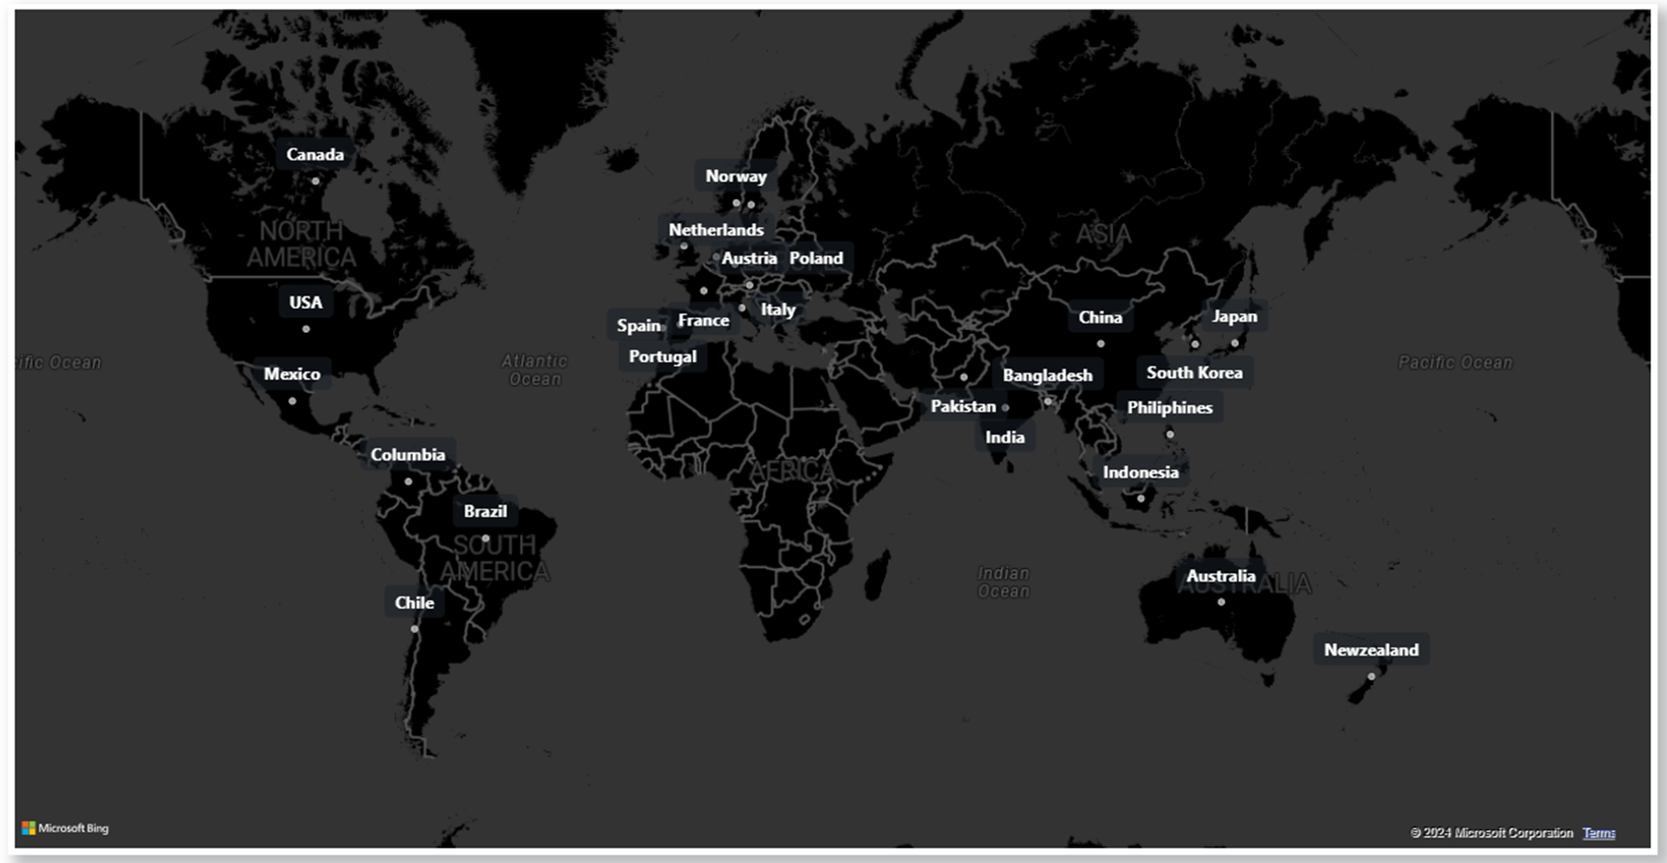
Atliq’s business markets

Slide 5
Atliq’s Products
PC
P&A
N&S
Desktop
Notebook
Peripherals
Accessories
Networking
Storage
1.Business desktop 2.Personal desktop
1.Gaming laptop 2.Personal laptop 3.Business laptop
1.Graphics card 2.Internal HDD 3.Mother board 4.Processors
1.Battery 2.Keyboard 3.Mouse
1.WiFi extender
1.External SSD 2.USB Flash drive

Slide 6
data inputs
It’s Contains 2020 – 2021 Fiscal year data available
dim_customer
dim_product
fact_gross_price
fact_manufacturing_cost
fact_pre_invoice_deductions
fact_sales_monthly

Slide 7
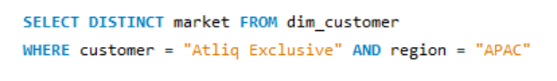
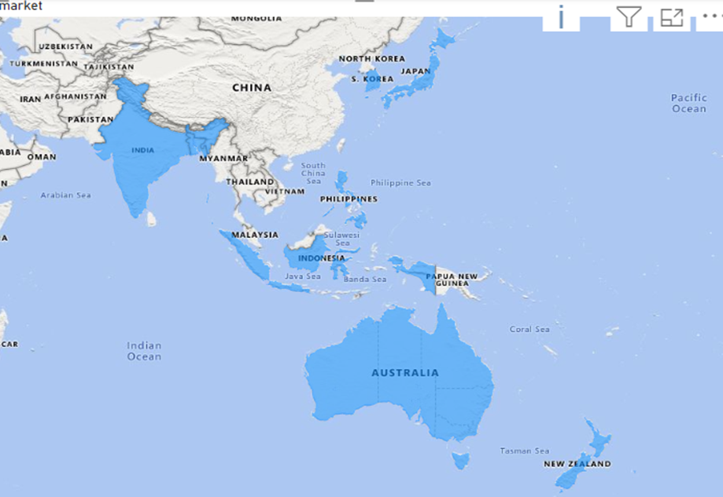
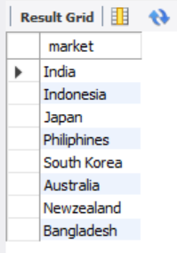
Ad-hoc request along with the result, visualization and insights REQUEST NO : 01
Provide the list of markets in which customer Atliq Exclusive operates it’s business in the APAC region.
Query
INSIGHTS
Atliq Exclusive has the most stores-8 in APAC region followed by 6 in EU and 2 in NA.
Result

Slide 8
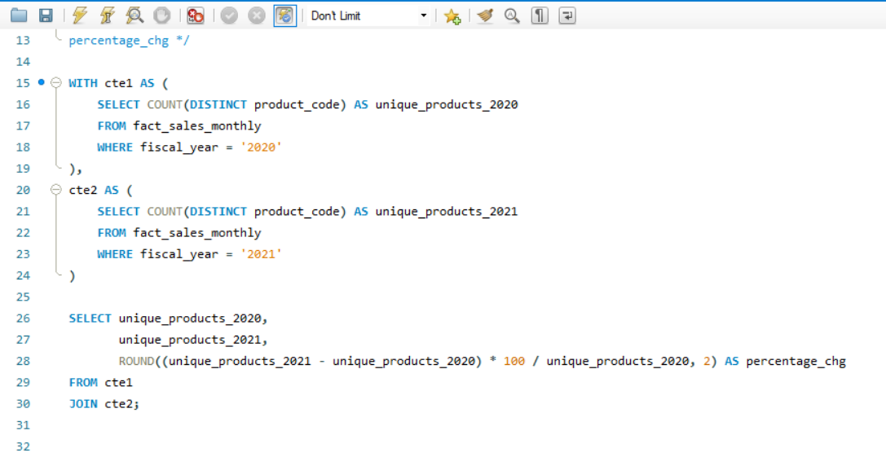
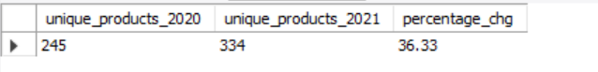
REQUEST NO : 02
What is the percentage of unique product increase in 2021 vs. 2020? The final output contains these fields, unique_products_2020 unique_products_2021 percentage_chg
Query
Result

Slide 9
INSIGHTS
400
300
200
100
0
There is 36.33% increase in unique products from 2020-245 to 2021-334 .
Launching 89 new products in a year is a positive sign, signalling not only business growth but also pro active response to market demands and a commitment to innovation.
334
245
36%
FY2020
FY2021
Percentage %
Unique products in FY2020 & 2021

Slide 10
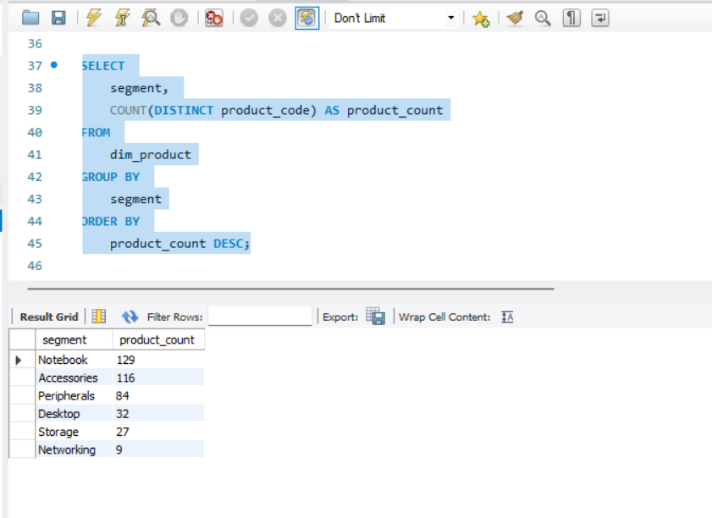
request no : 03
Provide a report with all the unique product counts for each segment and sort them in descending order of product counts. The final output contains 2 fields, segment and product_count.

Slide 11
insights
Out of 6 segments, Notebook has the highest number of products_count (129) and networking has the lowest (9).
The Notebook, Accessories and peripherals segments dominates the product range comprising 82.87% of Atliq’s total product offerings.
Atliq ought to focus on expanding its product offerings in the Desktop, Storage and Networking segment to scale the business while also aligning with the current market trends and demands.

Slide 12
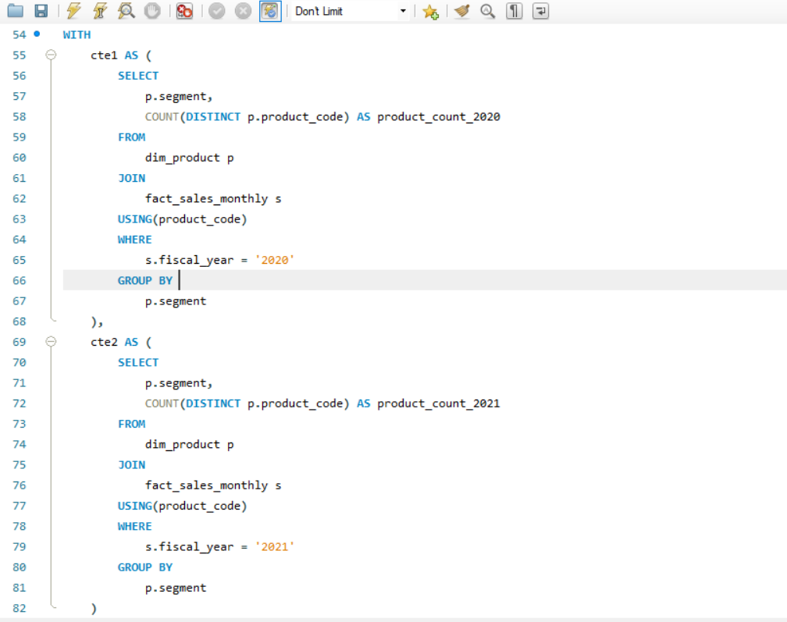
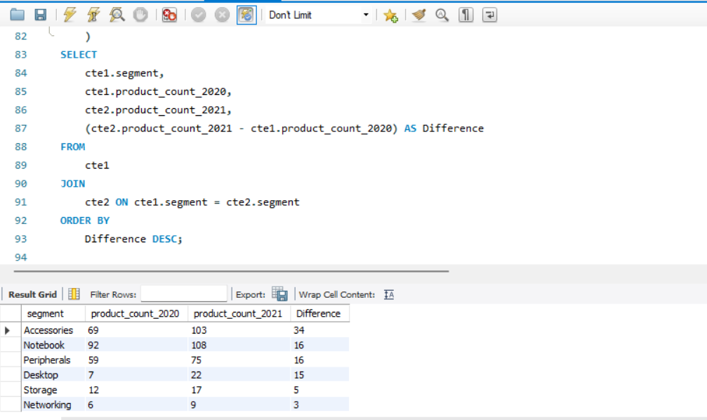
request no : 04
Which segment had the most increase in unique products in 2021 vs 2020? The final output contains these fields, segment, product_count_2020, product_count_2021, and difference.

Slide 13
insights
Atliq had introduced 34 new products in accessories segment marking the largest product addition among other segments.
The Desktop segment saw the highest percentage difference with the addition of 15 new products which makes 214% increase compared to 7 products in 2020.
Networking and Storage have experienced the lowest production growth.

Slide 14
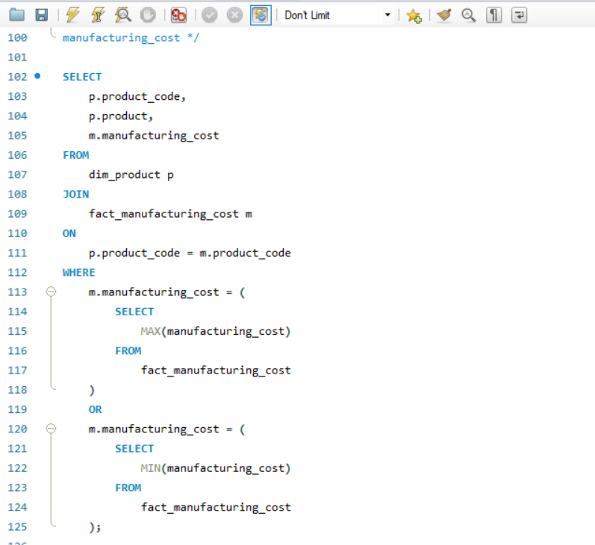
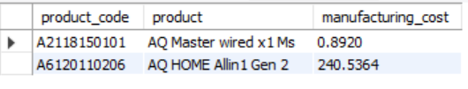
request no : 05
Get the products that have the highest and lowest manufacturing costs. The final output should contain these fields, product_code, product, manufacturing_cost
INSIGHTS
AQ Master wired x1 Ms has the lowest manufacturing cost of $ 0.89 where as AQ HOME Allin 1 Gen 2 has the highest manufacturing cost of $ 240.53.

Slide 15
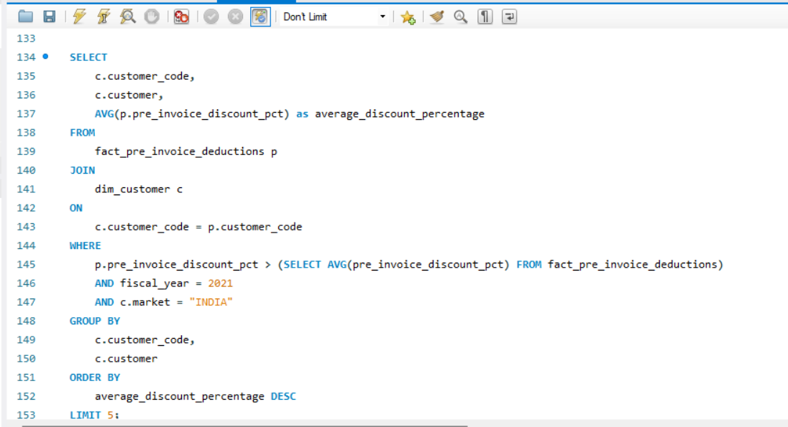
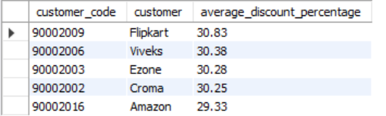
REQUEST NO : 06
Generate a report which contains the top 5 customers who received an average high pre_invoice_discount_pct for the fiscal year 2021 and in the Indian market. The final output contains these fields, customer_code, customer, average_discount_percentage.

Slide 16
INSIGHTS
This report can be useful for understanding which customers in the Indian market are receiving the highest pre-invoice discounts and for identifying potential areas for cost-saving measures.
Flipkart received the highest average discount of 30.83% in fiscal year 2021 in India, marking it as the most discounted customer. Approximately equal average discount percentages were offered to each of our top 5 customers.

Slide 17
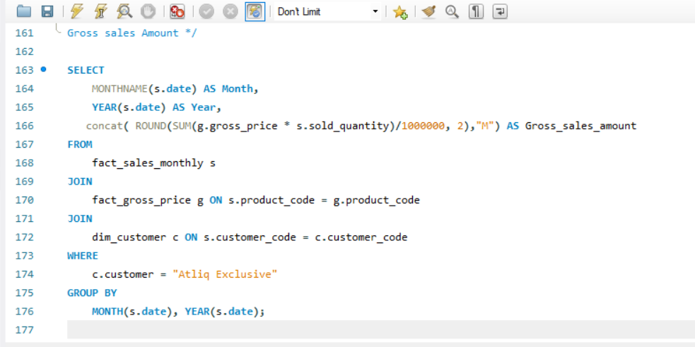
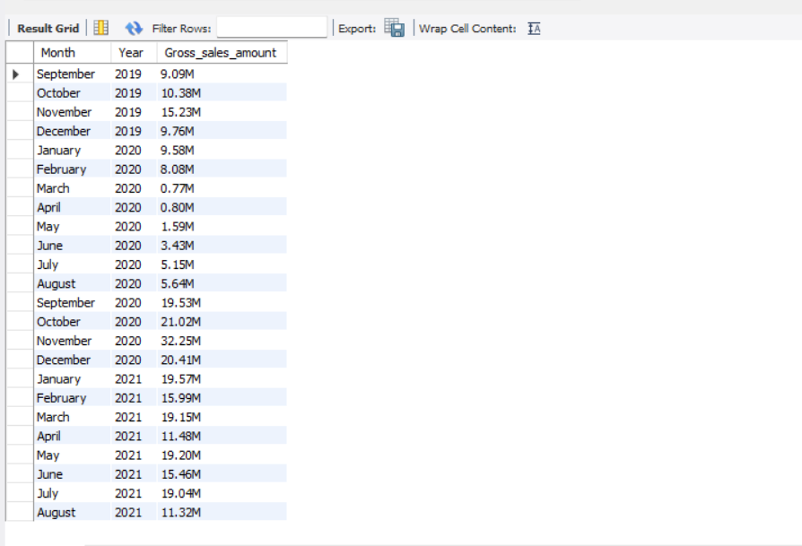
request no : 07
Get the complete report of the Gross sales amount for the customer “Atliq Exclusive” for each month . This analysis helps to get an idea of low and high-performing months and take strategic decisions. The final report contains these columns: Month, Year and Gross sales amount.

Slide 18
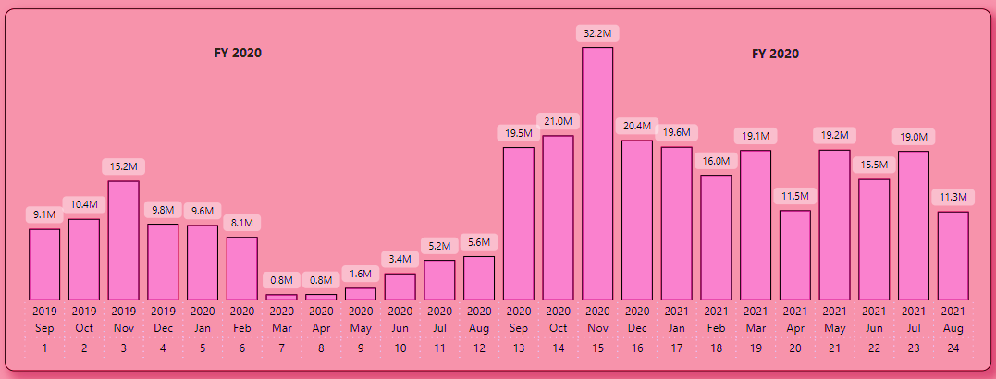
insights
AtliQ Exclusive sold the most stuff in November 2020 and the least in March 2020.
Sales dropped from March to August because of COVID-19. But now, things are looking up. Sales have been going up and are even better than they were in 2020.

Slide 19
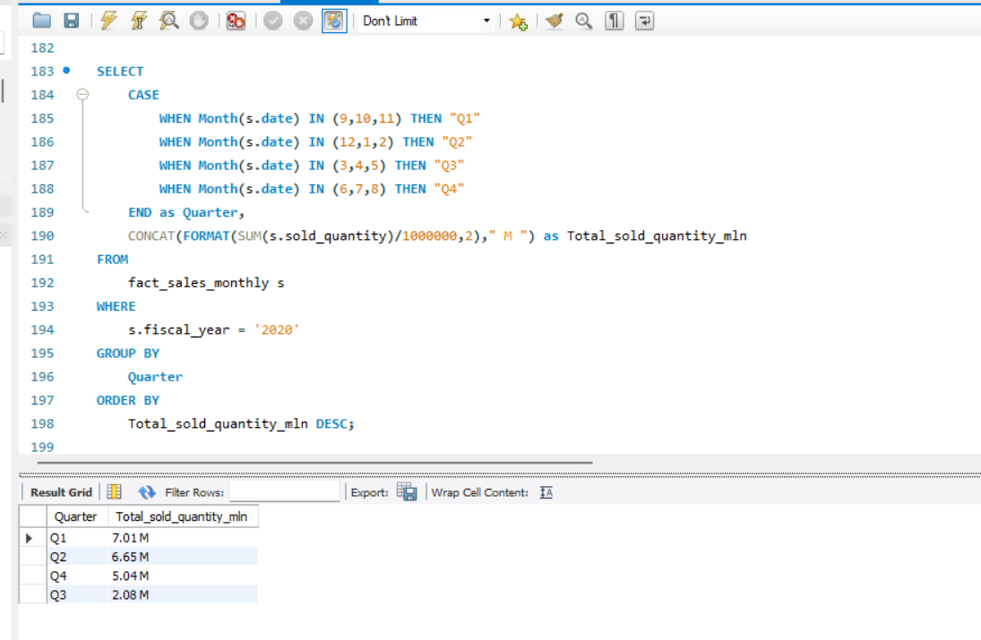
request no : 08
In which quarter of 2020, got the maximum total_sold_quantity? The final output contains these fields sorted by the total_sold_quantity, Quarter, total_sold_quantity

Slide 20
insights
FY2020 experienced its highest quantity sold during Q1 (September to December 2019), demonstrating strong performance driven by the festive season in India.
Sales experienced a downturn in Q3 (March to May 2020), attributed to the effects of the pandemic.
In Q4, there was a notable uptick in sales, signaling a promising trend of recovery.

Slide 21
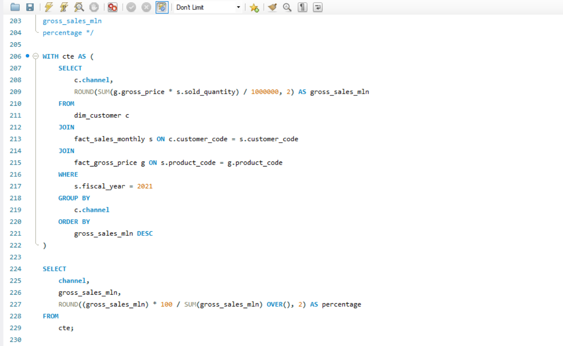
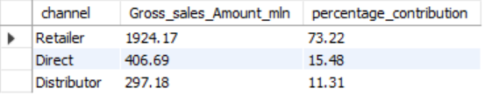
request no : 09
Which channel helped to bring more gross sales in the fiscal year 2021 and the percentage of contribution? The final output contains these fields, channel, gross_sales_mln, percentage.

Slide 22
insights
The Retailer channel was the top-performing sales channel for the company in fiscal year 2021. this channel performed so well compared to the Direct and Distributor channels.

Slide 23
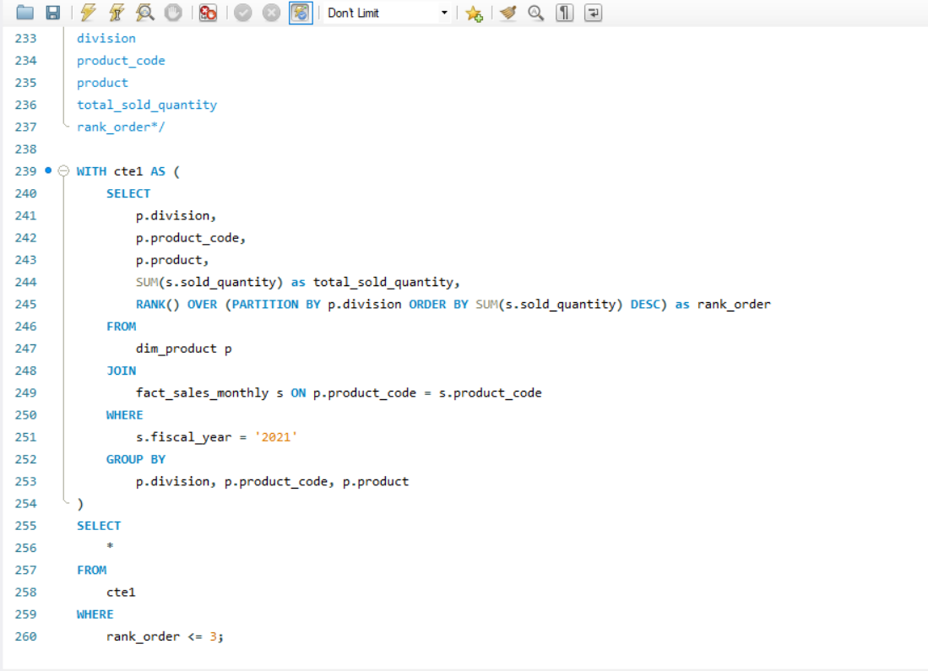
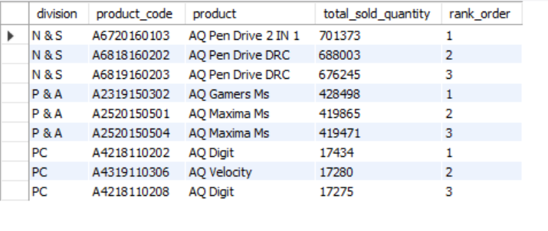
request no: 10
Get the Top 3 products in each division that have a high total_sold_quantity in the fiscal_year 2021? The final output contains these fields, division, product_code, product, total_sold_quantity, rank_order.

Slide 24
insights
The top-selling product in the N & S division is the AQ Pen Drive 2 IN 1, with a total quantity sold of 701,373 units. This is significantly higher than the second and third top-selling products in the same division.
In the P & A division, the difference in the quantity sold between the top-selling product (AQ Gamers MS) and the second and third top-selling products (AQ Maxima MS) is relatively small, with a difference of only a few hundred units sold.
The AQ Digit is the top-selling product in the PC division, with a total quantity sold of 17,434 units. However, the difference in quantity sold between the top-selling and second and third top-selling products in this division is relatively small.

Slide 25
Thank you

